Slide 1
Chapter 1. OS OVERVIEW
Introduction
  1. What is an Operating System?
    A program that manages the computer hardware
    Provides a basis for application programs
    Acts as an intermediary between the computer user and hardwares
  1.2. What Operating System do
  A computer system can be divided into four components: the hardsware, the operating system, the application programs and users.
    User view
    System view

Slide 2
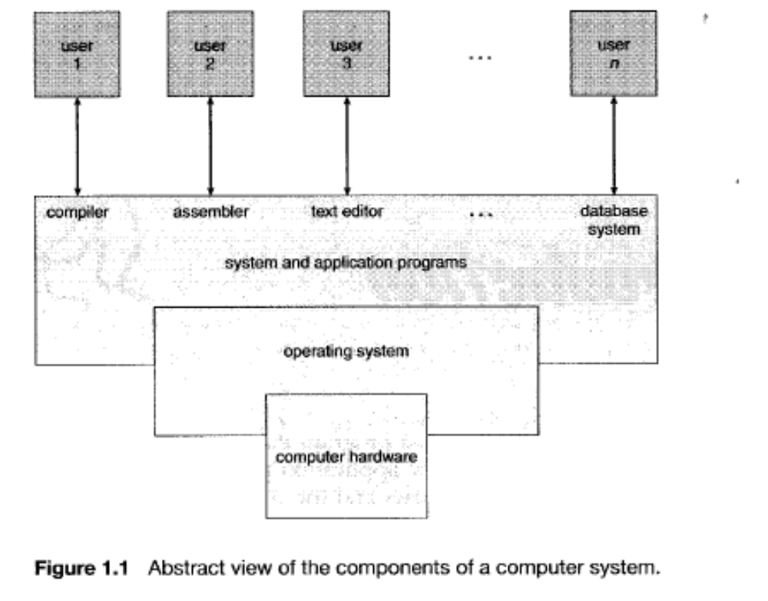
Figure 1.1. Abstract view of the components of a computer system

Slide 3
  1.2.1. User View
    The user’s view of the computer varies according to the interface being used
    One user to monopoly resource
    Many users access the computer
    Many users sit at workstations connected to networks of other workstation and servers
    Handheld computer
    Embedded computer in home devices and automobiles.

Slide 4
    1.2.2. System View
    An operating system is the program most intimately involved with the hardware. An operating system as a resource allocator-> the manager of the resource.
    An operating system is a control program that manages the execution of the user programs to prevent errors and improper use of the computer.
    It is especially concerned with the operation and control of I/O devices.

Slide 5
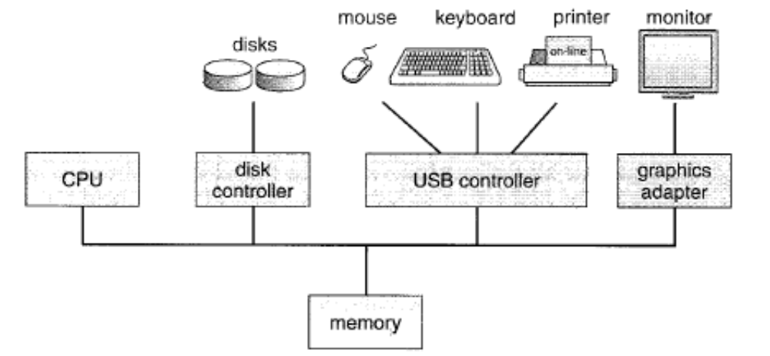
1.3. Computer System Organnization
One or more CPUs
Device controller connected to common bus that provides access to share memory.
CPU and device controller can execute concurrently.
Memory controller provides whole function is to synchronize access to the memory.
Figure 1.2. A modern coputer system

Slide 6
1.3.1. Computer System Operation
    When it is power up or reboot- it needs to have an initial program or bootstrap program to run. Bootstrap program is stored in ROM.
    Bootstrap program initalizes all aspects of the system, from CPU register to device controllers to memory contend.
    To load the operating system and start executing the system, bootstrap program must locate and load into memory the operating system kernel.
    The operating system then starts executing the first process-”init” and wait for some event to occur.

Slide 7
    The occurrence of an event is usually signaled by an interrupt from either the hardware or the software. Hardware may trigger an interrupt at any time by sending a signal to the CPU, usually by way of the system bus. Software may trigger an interrupt by executing a special operation called a system call (also called a monitor call).
    When the CPU is interrupted, it stops what it is doing and immediately transfers execution to a fixed location. The fixed location usually contains the starting address where the service routine for the interrupt is located. The interrupt service routine executes; on completion, the CPU resumes the interrupted computation.

Slide 8
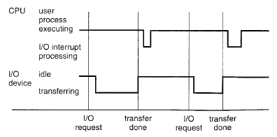
Figure 1.3. Interrupt time line for a single process doing output

Slide 9
1.3.2. Storage Structure
    Computer programs must be in main memory (RAM) to be executed.
    RAM is only storage area that the processor can access directly.
    RAM forms an array of memory words. Each word has its own address.
    Interaction is achieved through a sequence of load or store instruction to specific memory address.
    The load moves a word from RAM to an internal register within the CPU, whereas the store instruction moves the contend of a register to RAM.

Slide 10
    RAM is usually too small to store all needed program and data permanently.
    RAM is volatine storage device that loses its contends when power is turned off or otherwise lost.
    The most computer system provide secondary storage as an extension of main memory.
    The wide variety of storage system in a computer system can be organized in a hierarchy according to speed and cost.
      Higher levels are expensive, fast.
      Move down: cost per bit decreases, access time increases

Slide 11
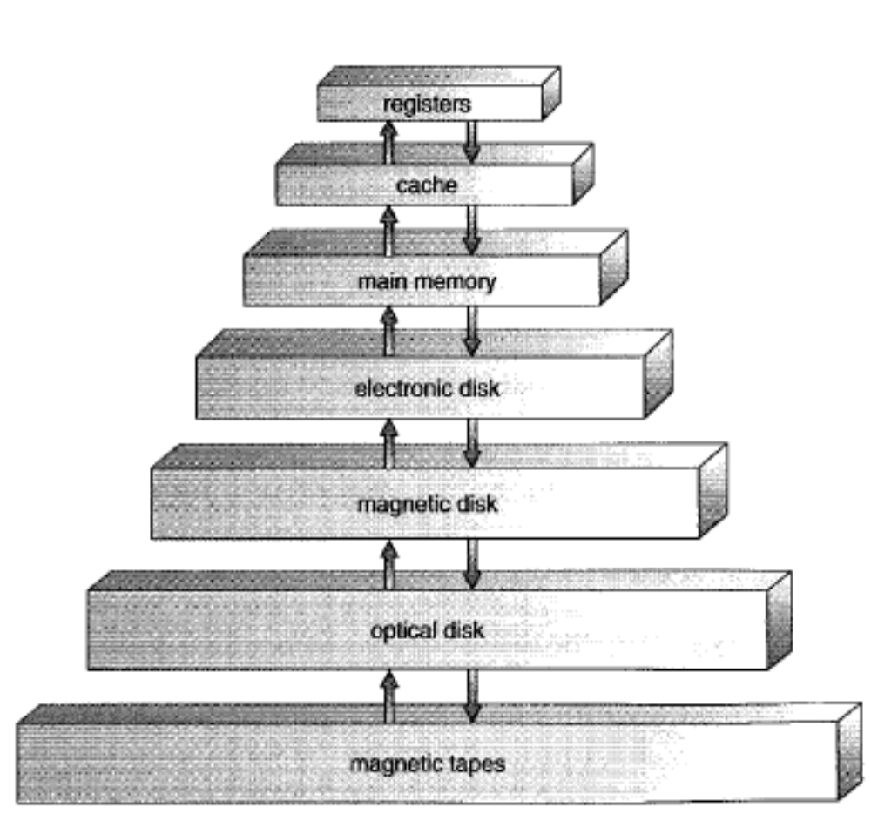
Figure 1.4. Storage device hierarchy
The storage systems above the electronic disk are volatile, whereas those below are nonvolatile.

Slide 12
1.3.3. I/O Structure
    A large portion of operating system code is dedicated to managing I/O, both because of its importance to the reliability and performance of system and because of the varying nature of the device.
    Computer system have multiple device controller that are connected throught a common bus.
    Each device controller is in charge of a specific type of device. There may be more than one attached device.

Slide 13
    A device controller maintains some local buffer storage and a set of special-purpose register.
    The device controller is responsible for moving the data between the peripheral devices that it control and its local buffer storage.
    The operating systems have a device driver for each device controller. The device driver understands the device controller and present a uniform interface to the device to the rest of the operating system.

Slide 14
    To start an I/O operation, the device driver loads the appropriate registers within the device controller.
    The device controller examines the contends of these registers to determine what action to take (such as “read a character from the keyboard).
    The controller starts the transfer of data from the device to its local buffer, informs the device driver via an interrupt that it has finished its operation.
    The device driver then return control to the operating system.

Slide 15
    DMA (Direct memory access) is used for bulk data movement such as disk I/O
      Device controller transfers an entire block of data directly to or from its own buffers storage to memory with no intervention by the CPU.
      Only one interrupt is generated per block, to tell the device driver that the operation has completed, rather than the one interrupt per byte generated for slow-speed devices.
      CPU is available to accomplish other work.

Slide 16
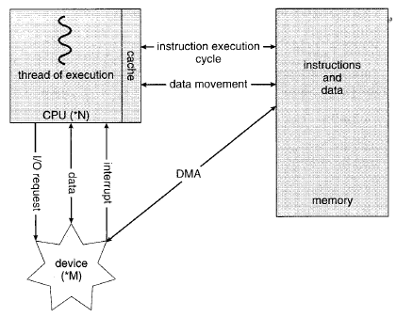
Figure 1.5. How a modern computer system works

Slide 17
1.4. Computer System Architecture
  A computer may be organized in a number of different ways
1.4.1.Single Processor System
  There is one main CPU capable of execute a general-purpose instruction set, including instruction from user process.

Slide 18
  Almost all system have other special-purpose processors as well. They may come in the form of device-specific processor, such as disk, keyboard, graphics controller…They may come in the form of more general-purpose processors such as I/O processors that move data rapidly among the components of the system.
  Special-purpose processors are low-level components built into the hardware.
  The use of special-purpose microprocessors is common and does not turn a single-processors system into a multiprocessor. If there is only one general-purpose CPU, then the system is a single-processor system.

Slide 19
  1.4.2.Multiprocessor System
  Multiprocessor system (parallel system or tightly coupled system) have two or more processors in close communication, sharing the computer bus and sometimes the clock, memory or peripheral devices.
  Multiprocessor system have three main advantages
    Increased throughput: more work done in less time.

Slide 20
    Economy: Multiprocessor system can cost less than equivalent multiple single-processor system because they can share periphrals, mass storage and power supplies.
    Increase reliability: If functions can be distributed properly among several processors, then the failure of one processors will not halt the system, only slow it down.
  The multiprocessor system in use today are of two types.

Slide 21
    Asymmetric multiprocessing: Each processor is assigned a specific task. A master processor controls the system. The other processors either look to the master for instruction or have predefined tasks. This scheme defines a master-slave relationship. The master processor schedules and allocates work to the slave processors.
    Synmetric multiprocessing (SMP): the most common system use. Each processor performs all tasks within the operating system. All processors are peers, no master-slave relationship exist between processors.

Slide 22
    SMP is the model that many process can run simultaneously-N processes can run if there are N CPUs-without cause a significant deterioration of performance. However, OS must carefully control I/O to ensure that the data reach the appropriate processor. Also, since the CPU are separate, one may be sitting idle while another is overloaded, resulting in inefficiencies. These inefficiencies can be avoided if the processors share certain data structures.

Slide 23
    The difference between symmetric and asymmetric multiprocessing may result from either hardware or software. Special hardware can differentiate the multiple processors, or the software can be written to allow only one master and multiple slaves.
    A recent trend in CPU design is to include multiple computer cores on a single chip. The multi-core CPUs look to the operating system just as N standard processors.

Slide 24
    Blade servers are a recent development in which multiple processor boards, I/O boards, and networking boards are placed in the same chassis. The difference between these and traditional multiprocessor system is that each blade-processor board boots independently and run own operating system. Those servers consist of multiple independent multiprocessor systems.

Slide 25
1.4.3. Clustered System
  Another type of multiple-CPU system.
  Like multiprocessing systems, clustered systems gather together multiple CPUs to accomplish computational work.
  Clustered systems differ from multiprocessor system that they are composed of two or more individual systems coupled together.
  The generally accepted definition is that clustered computers share storage and are closely linked via a local area network.

Slide 26
  Clustering is usually used to hight availability service, that is service will continue even if one or more system in the cluster fail. Hight availability is generally obtained by adding a level of redundancy in the system.
  A layer of cluster software runs on the cluster nodes. Each node can monitor one or more of the others (over LAN). If the monitored machines fails, the monotoring machine can take ownership of its storage and restart the applications that were running on the failed machine.

Slide 27
  Clustering can be structured asymmetrically or symmetrically.
  In asymmetric clustering, one machine is in hot-standby mode while the other is running the applications. The hot-standby host machine does nothing but monitor the active server. If the server fails, the hot-standby host becomes the active server
  In symmetric mode, two or more hosts are running applications and are monitoring each other. This model is more efficient, as it uses all of the available hardware. It does require that more than one application be available to run.

Slide 28
  Cluster technology is changing rapidly. Some cluster products support dozens of system in a cluster, as well as clustered nodes that are separated by miles.
  Many of improvements are made possible by storage-area-networks (SANs) which allow many systems to attach a pool of storage.
  If the applications and their data are stored on the SAN, then the cluster software can assign the application to run on any host that is attached to the SAN. If the host fails, then any other host can take over.

Slide 29
1.4.4. Distributed Systems
  A distributed system is a collection of loosely coupled processors interconnected by communication network.
  The processors in a distributed system may vary in size and function. They may include small microprocessors, workstations, minicomputers, and large general-purpose computer systems.
  These processors are referred to by a number of names, such as sites, nodes, computers machines, and hosts, depending on the context in which they are mentioned.
  We mainly use site to indicate the location of a machine and host to refer to a specific system at a site.

Slide 30
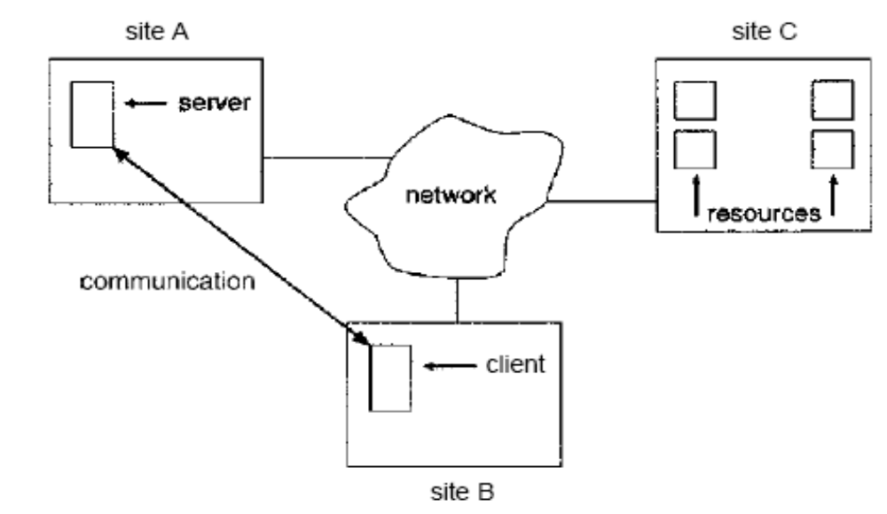
Figure 1.6. A distributed system
Generally,one host at one site, the server, has a resource that another host at another site, the client (or user), would like to use.

Slide 31
  1.4.5. Special-purpose Systems
  Real-Time Operating Systems- Systems are characterized by having time as a key parameter. For example, in industrial process control systems.
  Embedded Operating Systems- Continuing on down to smaller and smaller systems, we come to palmtop computers and embedded systems. Embedded systems run on the computers that control devices that are not generally thought of as computers, such as TV sets, microwave ovens, and mobile telephones. These often have some characteristics of real-time systems but also have size, memory, and power restrictions that make them special.

Slide 32
1.5. Charateristic of Operating System
Internally, operating systems vary greatly in their makeup, since they are organized along many difference lines.However, there are many commonalities that we need consider
  1.5.1.Multiprogramming System
  One of the most important aspects of operating system is the ability to multiprogram. Multiprogramming increates CPU utilization by organizing jobs (data and code) so that the CPU always has one to execute.
  In this system, the operating system keeps several jobs in memory simultaneously.

Slide 33
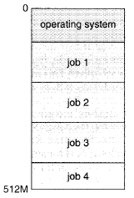
  The set of jobs can be a subset of the jobs kept in the job pool-which contains all jobs that enter the system. The number of jobs that can be kept simultaneously in memory is usually smaller than the number of jobs that can be kept in the jobs pool.
  The operating system picks and begins to execute one of the jobs in the memory.
Figure 1.7. Memory layout for a multiprogramming system

Slide 34
  Multiprogramming systems provide an environment in which the various system resources (such as CPU, memory and peripheral devices) are utilized effectively but they do not provide for user interaction with the computer sytem.
  1.5.2. Time-sharing (or multitasking) system
  This is a logical extension of multiprogramming system.
  In time-sharing systems, the CPU executes multiple jobs by switching among them, but the switches occur so frequently that the users can interact with each program while it is running.

Slide 35
  Time sharing requires an interactive computer system which provides direct communication between the user and the system. The user gives instruction to the operating system or to a program directly, using an input device and waits for immediate results on an output device.
  A time sharing operating system allows many users to share the computer simultaneously. Since each action or command in a time sharing system tend to be short, only a little CPU time is need for each user.

Slide 36
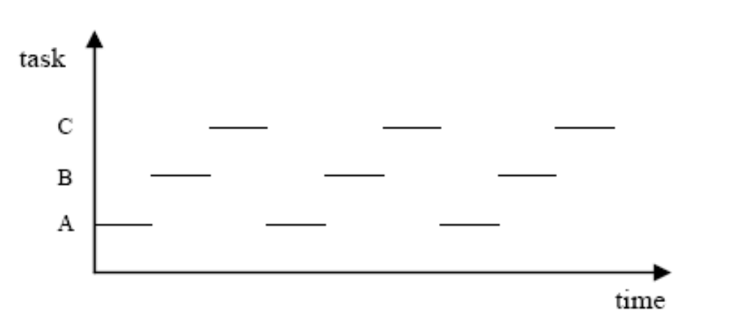
Figure 1.8. Using CPU in the time-sharing system
  As the system switches rapidly from one user to the next, each user is given the impression that the entire computer system is dedicated to his use, even though it is being shared among many user

Slide 37
  A time sharing operating system uses CPU scheduling and multiprogramming to provide each user with a small portion of a time-shared computer. Each user has at least one separate program in memory. A program loaded into memory and executeing is call a process

Slide 38
  1.6. Operating System Operations
  Modern operating systems are interrupt driven.
  If there are no processes to execute, no I/O devices to service, and no user to whom to respond, an operating system will sit quietly, waiting for something to happen.
  Events are almost always signaled by the occurrence of an interrupt or trap.
  A trap (or an exception) is a software-generated interrupt caused either by an error (division by zero or invalid memory access) or by a specific request from a user program that an operating system service be performed.

Slide 39
  For each type of interrupt, separate segments of code in the operating system determine what action should be taken.
  Since the operating system and the users share the hardware and software resources of the computer system, we (OS) need to make sure that an error in a user program could cause problems only for the one program that was running.
  With sharing, many processes could be adversely affected by a bug in one program.

Slide 40
  Without protection against these sorts of error, either the computer must execute only one process at a time or all output must be suspect.
  A properly designed operating system must ensure that an incorrect (or malicious) program cannot cause other programs to execute incorrectly.
  1.6.1. Dual-Mode Operation
  At the very least, we (OS) need two separate modes of operating system
    User mode
    Kernel mode (supervisor mode, system mode or privileged mode)

Slide 41
  A bit, called the mode bit, is added to the hardware of the computer to indicate the current mode: kernel mode (0) or user mode (1).
  With the mode bit, we are able to distinguish between a task that is executed on behalf of the operating system and one that is executed on behalf of the user.
  When the computer system is executing on behalf of a user application, the system is in the user mode. However, when a user application requests a service from the operating system (via a system call), it must transition from user to kernel mode to fulfill the request.

Slide 42
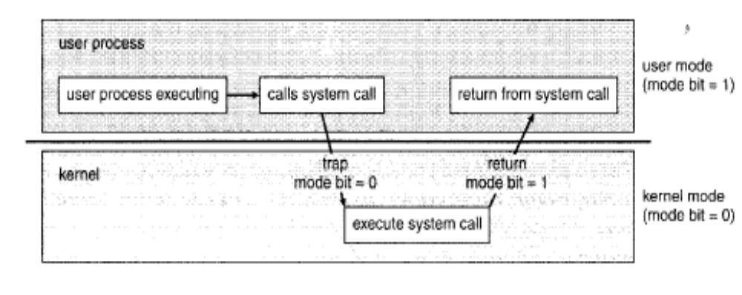
Figure 1.9. Transition from user to kernel mode

Slide 43
  At system boot time, the hardware starts in kernel mode. The operating system is then load and starts user applications in user mode.
  Whenever, a trap or interrupt occurs, the hardware switches from user mode to kernel mode. Thus, whenever the operating system gains control of the computer, it is in kernel mode.
  The system always switches to user mode before passing control to a user program.

Slide 44
  The dual mode of operation provides us with the means for protecting the operating system from errant users-and errant users from one another.
  Accomplish this protection by designating some of machine instructions that may cause harm as privileged instructions. The hardware allows privileged instructions to be executed only in kernel mode.
  If an attempt is made to execute a privileged instruction in user mode, the hardware does not execute the instruction but rather treats it as illegal and traps it to operating system.

Slide 45
  System calls provide the means for a user program to ask the operating system to perform tasks reserved for the operating system on the user program’s behalf.
  A system call is invoked in a variety of ways, depending on the functionality provided by the underlying processor. In all forms, it is the method used by a process to request action by the operating system.

Slide 46
1.6.2. Timer
  To ensure that the operating system maintains control over CPU and must prevent a user program from getting stuck in an infinite loop or not calling system services and never return control to the operating system.
  The operating system uses timer to accomplish this goal.
  A timer can be set to interrupt the computer after a specified period.
  The period may be fixed or variable. A variable timer is generally implemented by a fixed-rate clock and a counter.

Slide 47
  The operating system sets the counter. Every time the clock ticks, the couter is decremented. When the counter reaches 0, an interrupt occurs
  Before turn over control to the user, the operating system ensures is set to interrupt. If the timer interrupts, control transfers automatically to the operating system, which may treat the interrupt as a fatal error or may give the program more time.
  We can use the timer to prevent a user program from running too long. A simple technique is to initialized a counter with the a mount of time that a program is allowed to run.

Slide 48
1.7. Process Management
  A program does nothing unless its instructions are executed by a CPU. A gropram in execution is a process.
  A process needs certain resources-including CPU time, memory, files and I/O devices to accomplish its task. These resources are either given to the process when it is created or allocated to it while it is running.
  In addition to the various physical and logical resources that a process obtains when it is created, various initialization data (input) may be pass along. When the process terminates, the operating system will reclaim any reusable resources.

Slide 49
  A process is the unit of work in a system. Such a system consists of a collection of processes, some of which are operating system processes (those that execute system code) and the rest of which are user processes (those that execute user code).
  The operating system is responsible
    Creating and deleting both user and system processes.
    Suspending and resuming processes
    Providing mechanisms for process synchronization.
    Providing mechanisms for process communication.
    Providing mechanisms for deadlock handling

Slide 50
  1.8. Memory Management
  The main memory is central to the modern computer system. Main memory is a large array of words or bytes. Each words or bytes has its own address.
  The main memory is a repository of quickly accessible data shared by the CPU and I/O devices.
  The central processor read and write data from main memory.
  For a program to be executed, it must be mapped to absolute addresses and load into memory.

Slide 51
  As the program executes, it accesses program instructions and data from memory by generating these absolute addresses.
  Eventually, the program terminates, its memory space is declared available, and the next program can be loaded and executed.
  The operating system is responsible
    Keeping track of which parts of memory are currently being used and by whom.
    Deciding which processes and data to move and out of memory.
    Allocating and deallocating memory space as needed.

Slide 52
  1.9. Storage Management
  To make the computer system convenient for users, the operating system provides a uniform, logical view of information storage. The operating system abstracts from the physical properties of its storage devices to define a logical storage unit-the file. The oprating system maps files onto physical media and accesses these files via the storage devices.

Slide 53
  1.9.1. File System Management
  Computers can store information on several different types of physical media. Each of these media has its own characteristics and physical organization. Each medium is controlled by a device such as disk drive or tape drive, that also has its own unique characteristics.
  The operating system implements the abstract concept of a file by managing mass storage media, such as tape and disk and the devices that control them. Also, files are normally organized into directories to make them easier to use.

Slide 54
  The operating system is responsible
    Creating and deleting files
    Creating and deleting directories to organize files.
    Supporting primitives for manipulating files and directories.
    Mapping files onto secondary storage
    Backing up files on stable (nonlatile) storage media.

Slide 55
  1.9.2. Mass-Storage management
  Most modern computer system use disks as a principal on-line storage medium for both program and data
  Most programs are stored on a disk until loaded into memory and then use the disk as both the source and destination of their processing. Hence, the proper management of disk storage is of central importance to a computer system.
  The operating system is responsible
    Free- space management
    Storage allocation
    Disk scheduling

Slide 56
  1.9.3. Caching
  Cashing is an important principle of computer system. Information is normally kept in some storage system (such as main memory). As it is used, it is copied into a faster storage system-the cashe-on a temporary basis.
  When we need a particular piece of information, we first check whether it is in the cash. If it is, we use the information directly from the cashe; if it is not, we use the information from the source, putting a copy in the cashe under the assumption that we will need it again soon.

Slide 57
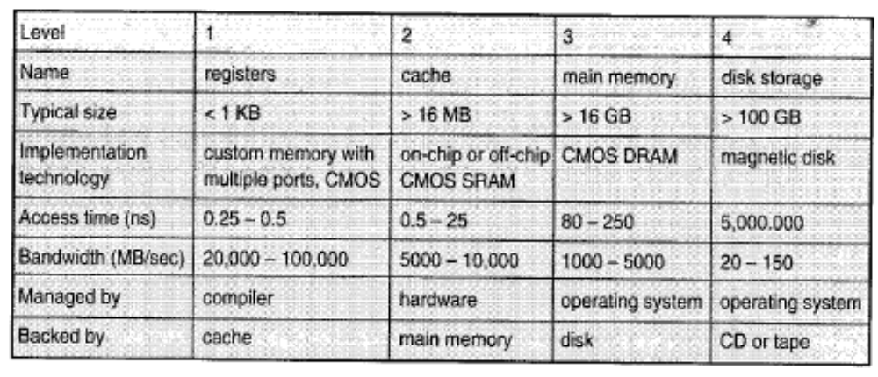
  Because caches have limit size, cache management is an important design problem. Careful selection of the cashe size and of a replacement policy can result in greatly increated performance.
Hình 1.9. Performance of various levels of storage

Slide 58
  1.10. Protection and security
  If a computer system has multiple users and allows the execution of multiple process, then access to data must be regulated. For that purpose, mechanisms ensure that files, memory segments, CPU, and other resources can be operated on by only those processes that have gained proper authorization from the operating system.
  Protection is any mechanism for controlling the access of processes or user to the resources defined by a computer.

Slide 59
  A system can have adequate protection but still be prone to failure and allow inappropriate access. Consider a user whose authentication information is stolen. Her data could be copied or deleted, even though file and memory protection are working.
  Security is that to defend a system from external and internal attacks. Such attack thread across a huge range and include viruses and worms denial-of-service, theft of service (unauthorized use of a system)…
  Protection and security require the system to be able to distinguish among all its users. Most operating systems maintain a list of user names and associated user identifier (user IDs).

Slide 60
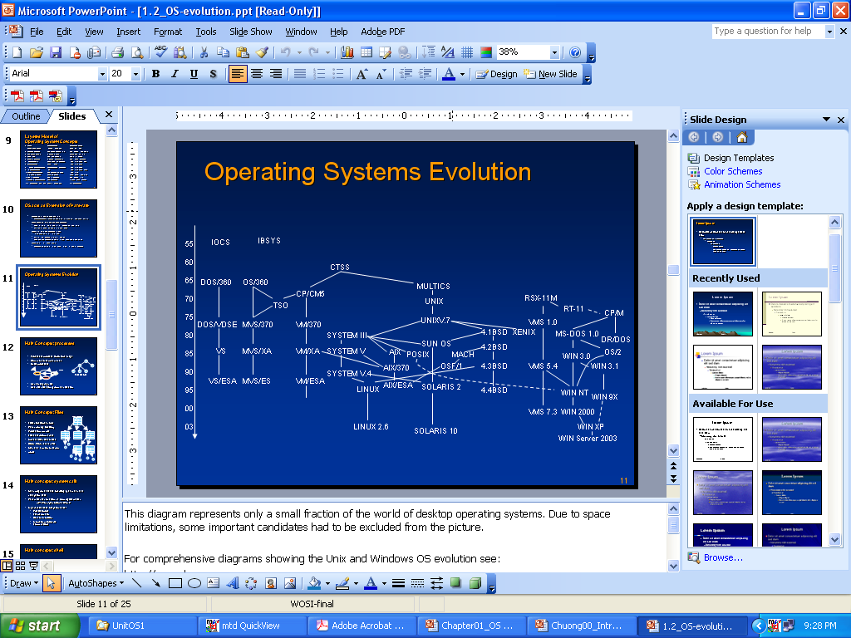
1.11. Operating System Evolution

Slide 61
  2. Operating System Structures (Reference)
  2.1.Operating System Services
  2.2.User Operating System Interface
  2.3.System Calls
  2.4.Type Of System Calls
  2.5.System Program
  2.6.Operating System Struture
  2.7.Virtual Machine
  2.8.Operating System Generation
  2.9.System Boot

Slide 62
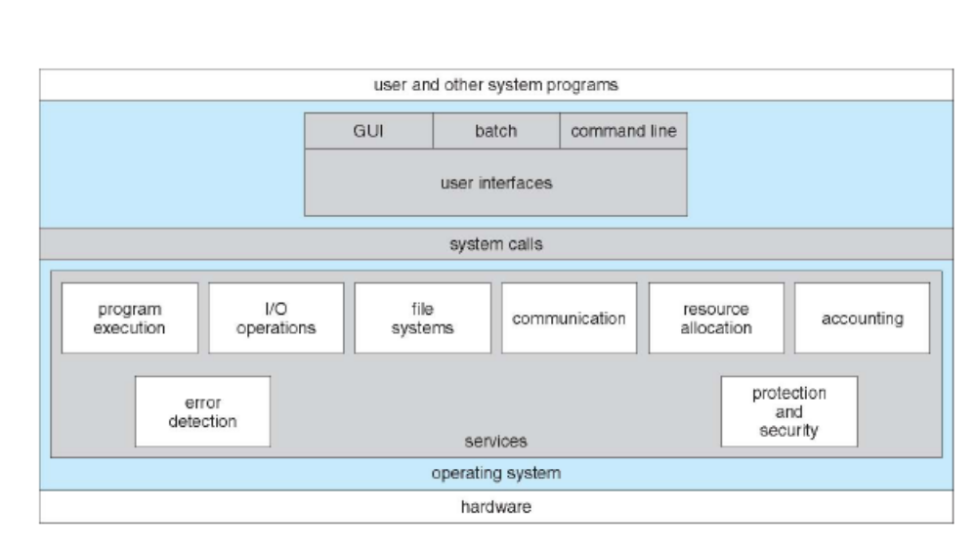
2.1.Operating System Services
Figure 2.1. Operating System Services

Slide 63
2.2.User Operating System Interface
  Command Line Interface (CLI) or command interpreter allows direct command entry.
  Graphical User Interfaces (GUI)
    Usually mouse, keyboard, and monitor
    Icons represent files, programs, actions, etc
    Various mouse buttons over objects in the interface cause various actions (provide information, options, execute function, open directory (known as a folder)
  Many systems now include both CLI and GUI interfaces

Slide 64
2.3. System Calls
  Programming interface to the services provided by the OS
  Typically written in a high-level language (C or C++)
  Mostly accessed by programs via a high-level Application Program Interface (API)rather than direct system call use
  Three most common APIs are Win32 API for Windows, POSIX API for POSIX-based systems (including virtually all versions of UNIX, Linux, and Mac OS X), and Java API for the Java virtual machine (JVM)
  Why use APIs rather than system calls?

Slide 65
2.4.Type Of System Calls
  Process control
  File management
  Device management
  Information maintenance
  Communications
  Protection

Slide 66
2.5.System Program
  Provide a convenient environment for program development and execution
  File management -Create, delete, copy, rename, print, dump, list, and generally manipulate files and directories
  Status information
  File modification
  Programming-language support -Compilers, assemblers, debuggers and interpreters sometimes provided
  Program loading and execution-Absolute loaders, relocatableloaders, linkage editors, and overlay-loaders, debugging systems for higher-level and machine language
  Communications -Provide the mechanism for creating virtual connections among processes, users, and computer systems

Slide 67
  2.6.Operating System Struture
  Simple structure
  Layered Approach
  Microkernels
  Modules

Slide 68
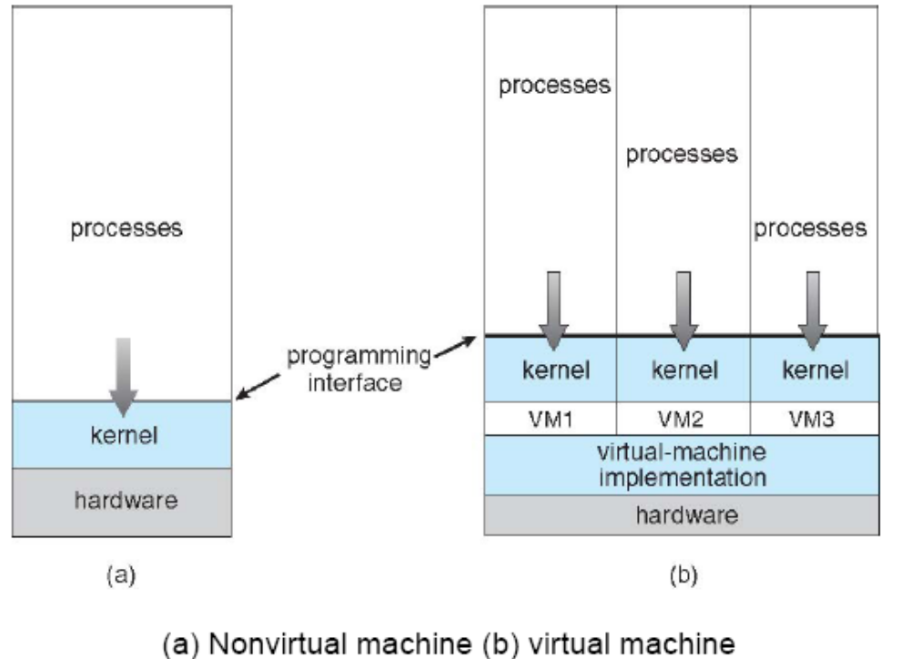
  2.7.Virtual Machine

Slide 69
2.8.Operating System Generation
  Operating systems are designed to run on any of a class of machines; the system must be configured for each specific computer site.
  SYSGEN program obtains information concerning the specific configuration of the hardware system.
  Booting–starting a computer by loading the kernel.
  Bootstrap program–code stored in ROM that is able to locate the kernel, load it into memory, and start its execution.

Slide 70
2.9.System Boot
  An operating system must be made available to hardware so hardware can start it.
  Reference: Silberschatz-Galvin-Gagne, Operating System Concepts, USA, 2005.(http://www.os-book.com)

